Slide 1
Introduction to the Knowledge and Library Hub
New interface
Revised slides 14 Jan 2026
Notes:
These slides offer a brief introduction to the Knowledge and Library Hub. They can be used by anyone with an interest and modified if required

Slide 2

Introductory page
Notes:
The NHS Knowledge and Library Hub gives quick and easy access to health and care evidence to support clinical practice, service improvement, research and professional development. In the next few minutes, we’ll look at how to access the Hub, how to search it and the main features that will help you find the information you need.
The Hub provides access to a wide range of medical, nursing, allied health and managerial resources, including books, journals and databases.

Slide 3
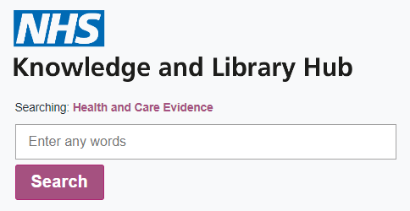
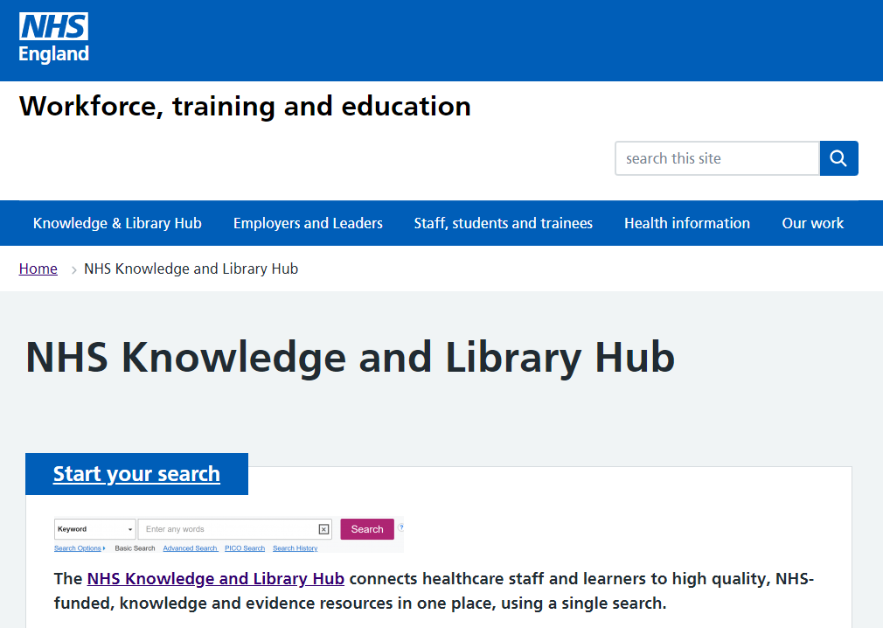

How to access the Hub
Via an embedded search box on your own site
www.library.nhs.uk/knowledgehub
Direct from the national site
Via a desktop link
Notes:
The NHS Knowledge and Library Hub is available through the national website at https://library.nhs.uk/knowledgehub/
You may have a desktop link in your organisation or an embedded search box for the quickest access
Most organisations in the NHS will have their own slightly different version of the Hub. You can find a link to yours here
https://knowledgehub.freshservice.com/support/solutions/articles/27000035291
Change in 2025 - The new Hub allows you to bookmark the page you are taken to after you follow the link. At present you still need to login to the right version of the Hub for your organisation or the generic version at www.library.nhs.uk/knowledgehub we hope to make it possible to login to any version and be delivered back to your one.

Slide 4
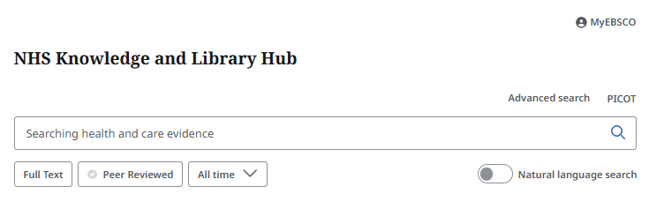
How does the Hub help?
Designed for quick searches
Designed to help people search effectively
Tailored for NHS staff and learners
Targets smooth access to fulltext
An entry point to expert support from a Knowledge and Library Service team where available locally

Slide 5

When might you use the Hub?
Finding a known article and accessing it
Broad brush searches
Finding something recent on a topic
Find the names of people writing on a topic
Looking for articles and books you can access right now
If you want to carry out better searches without needing to learn about more complex methods
Notes:
The Hub is very comprehensive for articles. It has excellent links to fulltext and easy requesting from your library if not immediately available
The Hub is good for searching across a wide range of sources quickly to get a feel for a topic
The Hub searches by relevance by default but can rapidly narrow down to recent publications
Sometimes it can be helpful to find someone writing on a topic
If you want something you can access straight away the Hub incorporates linking to a huge number of paid and open access items
Image from pixabay

Slide 6

When the Hub is likely not your best bet
For a systematic search
Where your question is more complex and detailed
If you want to use full features of a database like Medline or CINAHL
If you need a reproducible search
Notes:
The Hub is not designed for the kinds of in-depth systematic searches you might carry out in a database like Medline using an advanced search interface like Ovid or EBSCOHost.
The Hub enhances your search so it is not easy to tell exactly what terms have been searched which makes it unsuitable for when you need to report your search
Each organisation will have a slightly different version of the Hub and so your search is not always reproducible.
Image from Pixabay

Slide 7
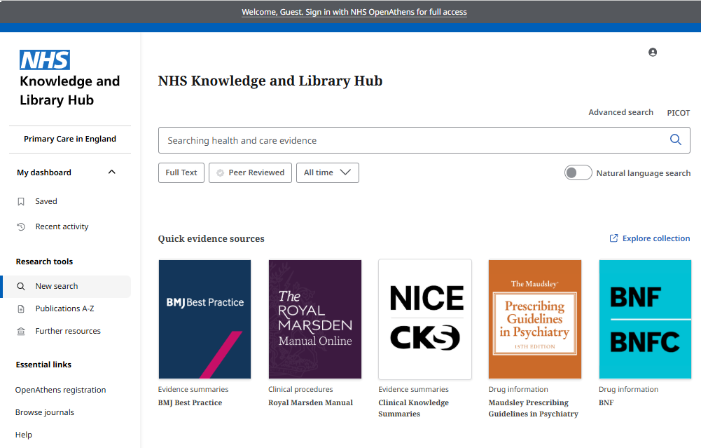
The importance of OpenAthens
Log in on arrival for the best experience…
To ensure you see the right version of the Hub for your organisation
To link to your library team
To see all the results
To have the smoothest path to fulltext
There is a link if you need to register for OpenAthens

Slide 8
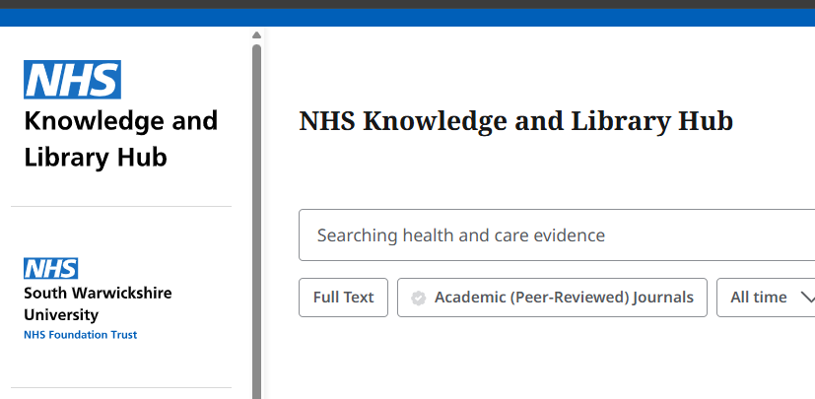
Am I on the right version of the Hub?
Check the organisation below the main Hub logo
If you arrive via www.library.nhs.uk then you need to login to go to your local version of the Hub
Notes:
It matters which version of the Hub you are on – getting the right version means you see the articles and ebooks that have been subscribed to for you by your organisation

Slide 9
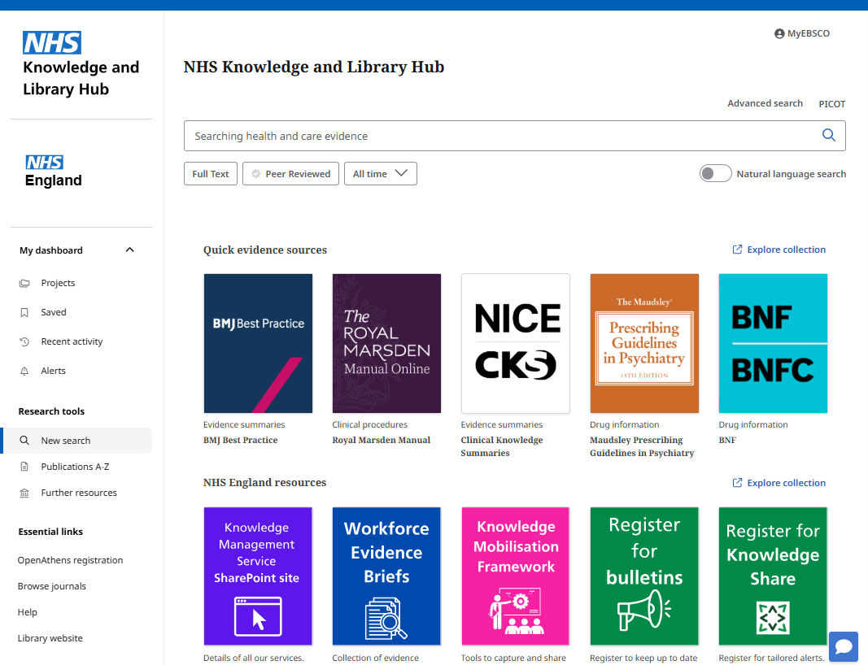
The Hub as a starting point
1
3
2
4
5
7
6
Notes:
A handy place for people to start their library research and access services
1. Quick evidence resources – helps you move quickly to search these key resources when you know they will offer a quick path to the evidence you need. These buttons appear on all Hub instances to support consistent easy access.
2. A further set of prominent buttons – these will highlight key services and further resource highlights specific to your organisation.
3. Further resources – you can find links to other important resources here including links to the advanced searching interfaces for literature databases such as Medline, CINAHL and EMBASE. The literature databases are listed with the search interface used for them – this will mostly be Ovid or EBSCOHost.
4. Browse journals – for a table of contents easy browse route to access journal articles from your library. Publications A-Z above offers a more traditional library look up list of journals (and some ebooks)
5. Help – click to access a set of super short videos to help you achieve key tasks on the Hub. Click More under any video if you would rather read more. A link to a more comprehensive set of guides is available in the final section of the help page
6. Library website – this will be a link to your library service webpage – it is likely also linked from your Trust logo
7. Ask – A – Librarian – generally this will offer a form to request help with a search or will link to the HLISD contact page for your library.

Slide 10
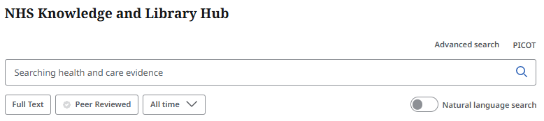
Searching on the Hub
Keep it simple
Default search is all words (ie AND)
Helpful suggestions as you type
“Phrase search in quotes”
The Hub adds plurals, related words and alternative spellings by default
Notes:
If you search multiple words the Hub will by default bring back records that include them all
The Hub helps by extending your search with related words and equivalent subjects

Slide 11
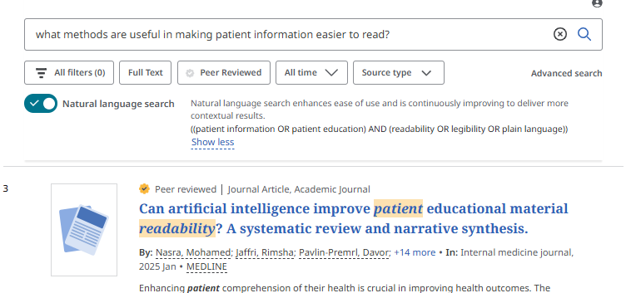
Searching using natural language search
Toggle to search using a query as you might ask a person
Ask long form questions
Your query is translated
Clicking “Show refined query” lets you check you have been understood
Notes:
If you search multiple words the Hub will by default bring back records that include them all
The Hub helps by extending your search with related words and equivalent subjects

Slide 12
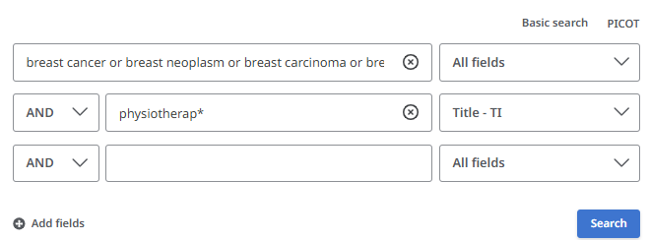
Searching on the Hub – using advanced search
Spelling it out for better results
A visual way to access fields and combine terms
Suggestions still pop up
Note wild card * (Physiotherapy, physiotherapist, physiotherapeutic etc)
Supports library users to do a better search and apply techniques learnt on in-depth interfaces
Notes:
Advanced search can help you think about your search and search in a particular journal or for a known author

Slide 13
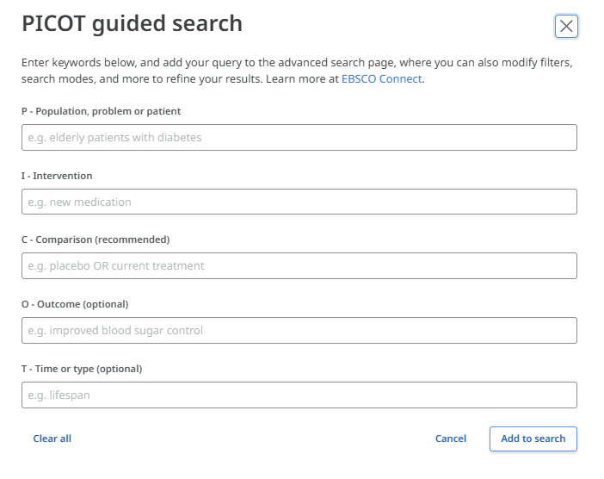
Searching on the Hub – PICOT?
Providing a structure
A way the Hub helps
Step by step support
Tips on screen
Not perfect but quick
Notes:
PICO is another option to help people think about their search in a more structured way. It is most helpful for questions around effectiveness
You must include elements under P and I

Slide 14
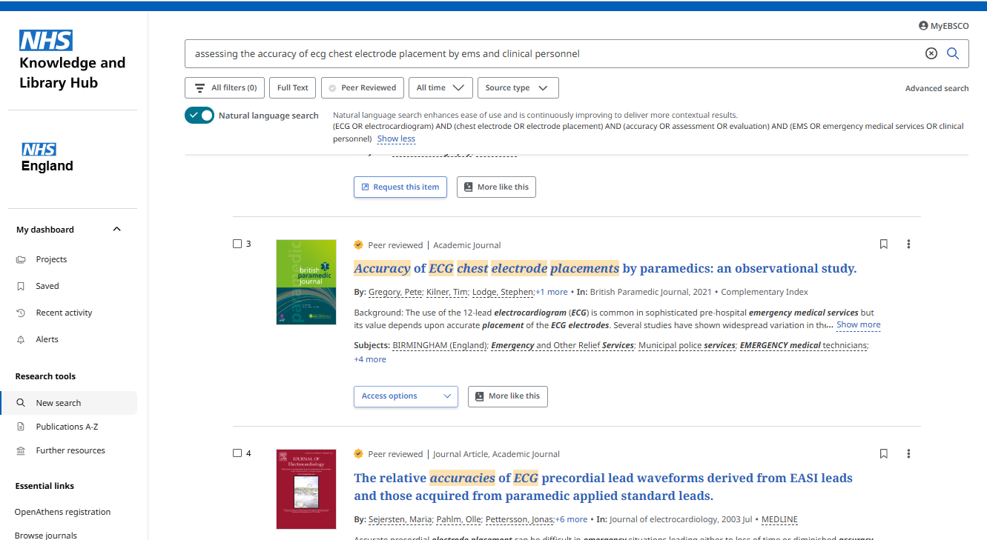
Results on the Hub
1
3
2
4
5
6
Notes:
When you have entered your search terms you will then be taken to your results page.
Filters can help you focus your search – the quick filters below the search box are those most commonly used
Lots of hits – you might have lots of hits (this example doesn’t!) but you wouldn’t worry on Google and you shouldn’t on the Hub – you are not going to read them all
Natural Language Search – if you used natural language search you can click to see the structured query created by the Hub. Check to make sure this is what you wanted
Choice of relevance or date order and save / set an alert – by default the Hub orders things based on what it thinks you are looking for. You can also up the number of results per page from the default 20. Click the three dots here to see the option to save your search or set an alert
Results in general – use Access options for the full text – If you have access to an item you will see the Access options drop down. This includes LibKey Instant PDF links for immediate access as well as retraction / expression of concern warnings and View complete issue which takes you to the Browse Journals experience to see the article in context. The bookmark icon on the top line lets you save a record and the three dots offers options to export your record or save it in a Project folder.
Recent activity – this is where you will find details of the searches you have tried in this session – you can combine searches here – it used to be called Search History

Slide 15
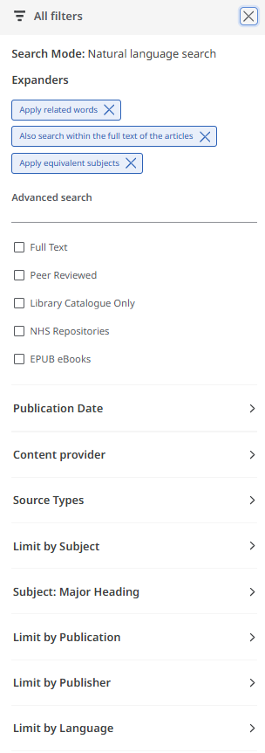

Results on the Hub – narrowing down
What you already have applied
You can remove related / equivalent to narrow your search
Most used:
  Full text (includes journals and books but does not include all the hybrid open access articles that are included in the results)
  Publication Date
Helpful:
  Library Catalogue Only (where available)
  NHS Repositories
Likely candidates
See next slide
Notes:
If you are looking to refine your search from the Result List, you can apply some limits – there are some quick limits below the search box or click “all filters” to see the full range of options. For example, you can limit by publication date, source type and subject terms.
NHS Repositories are local databases of publications by NHS organisations. These are a growing feature of the Hub.
The Content providers offers a good option if you want to find something from a known evidence source – examples might be BMJ Best Practice, Cochrane Systematic Reviews or NICE Guidance. Click and start typing to be brought to the one you want.
The Hub is enhanced with linking from Third Iron. This is carried out dynamically and adds links to thousands of open access articles in Hybrid journals. As this uses an external tool the Full Text limiter built into the Hub does not know to include these articles therefore you may find it better not to use the Full Text Limiter

Slide 16
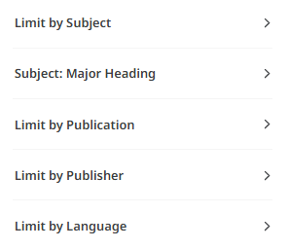
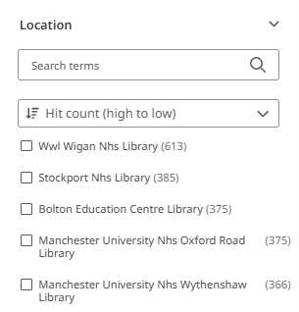

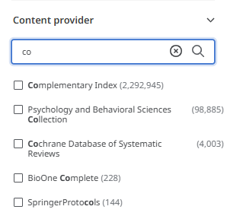
Results on the Hub – get closer
Would a particular journal help? Or focus on English language?
The model for searching on the Hub is generally to start with a general search and then narrow down by date, source or other options
Some libraries have a default limiter so that their ebooks and books are prioritised. If your All filters has a number in brackets and you haven’t applied a filter you have this
Pick books local to you
Narrow to Royal Marsden or Cochrane Reviews or BMJ Best Practice
Notes:
Limiting by Content Provider (previously labelled database) can be a good way to find something you know exists but that has not appeared in the first few results

Slide 17
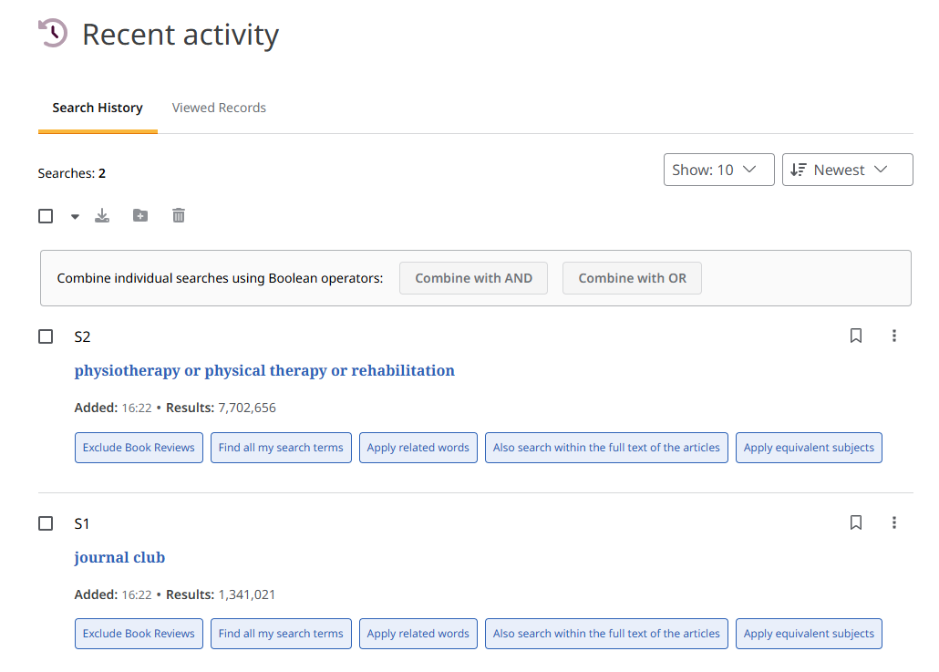
Results on the Hub – combine searches
Open Recent Activity to see your searches
Use the check boxes to pick sets
Combine using the buttons
AND narrows your search
OR broadens your search
Check your search box is clear before combining this way
Notes:
You can also combine by typing the S numbers eg S1 OR S2

Slide 18
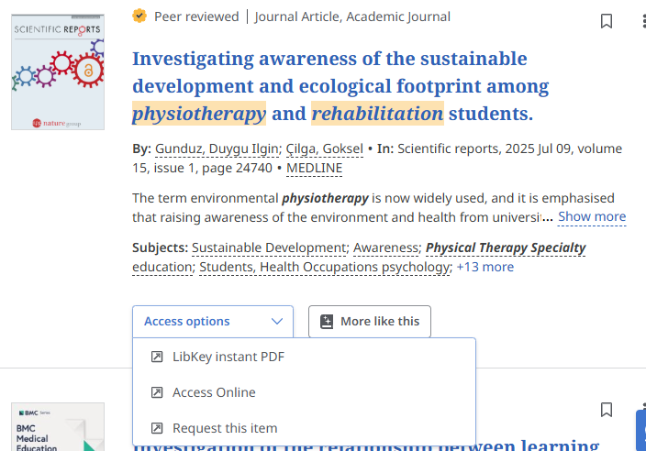
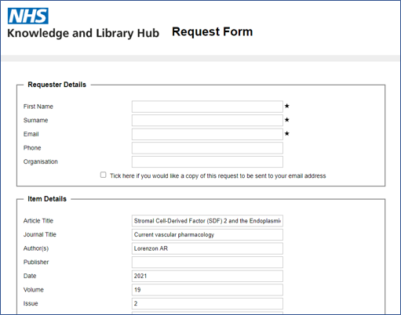
Results on the Hub – getting to full text
Click Access options to see choices
“LibKey Instant PDF” straight to the file
“Access Item” easier to read on screen (or if no PDF)
“View complete issue” article in context
“Request this item” for rapid supply via your library
Includes Retracted article warnings
Notes:
You can access the full text if its available by clicking on either the LibKey Instant PDF or Access Item buttons. If available, you can also view the complete issue of a journal. The NHS Knowledge and Library Hub gives you seamless access to the full text of licensed and open access articles. Where there an article has been retracted or there is an expression of concern this will be strongly flagged. You can click through for an explanation and access to the article where still available.
If you do not have full text access to a resource, you may be able to request a copy of an article from your NHS library. Click on the request button to send a pre-populated form to your library. You just need to complete your name and contact details to make the request.

Slide 19
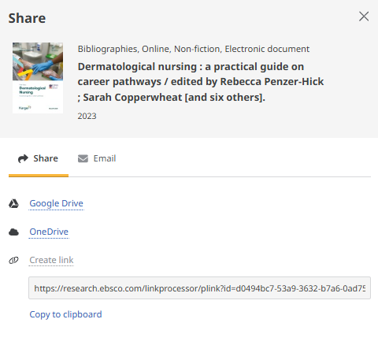
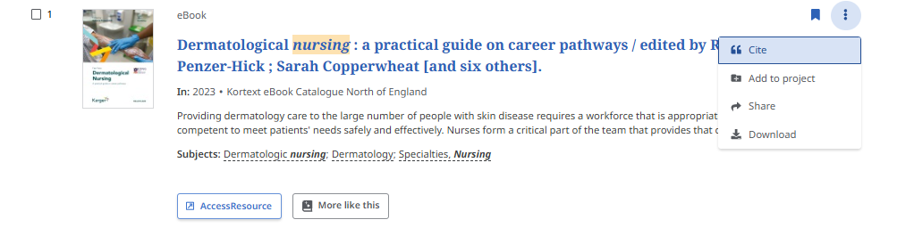
Results on the Hub – tips
“Cite” to copy or export to bibliographic software
“Share” for a shareable link or to share via email
“Download” offers Word, PDF, CSV and other formats

Slide 20
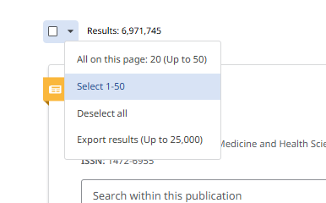
Results on the Hub – more tips
Click the drop down near the results total to see more options
You can export large sets of results up to 20 times per day
You will receive these via a download link in an email

Slide 21
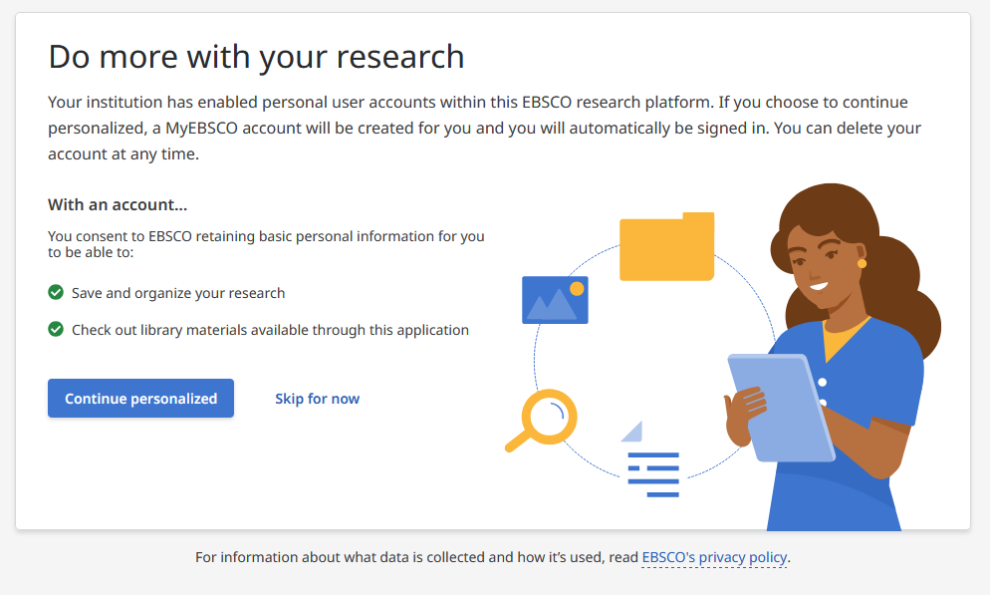
Results on the Hub – myEBSCO
On first login to your instance – prompted to set up an account
Future logins take you in immediately
Notes:
You are taken into your MyEBSCO account automatically – including when you login on the national gateway at www.library.nhs.uk/knowledgehub

Slide 22
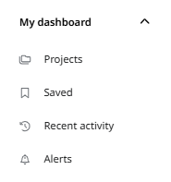

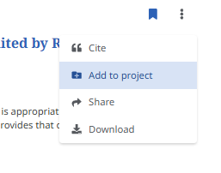
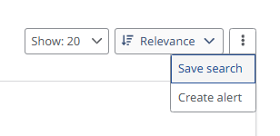
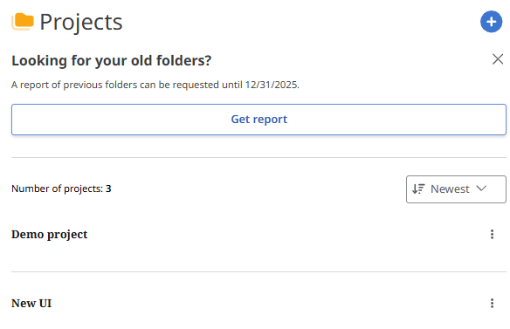
Results on the Hub – my Dashboard
You can save things you will need again
Projects can organise records related to a piece of work
Click the bookmark icon by a record to add to Saved
Recent activity is your search history the bookmark here saves that search statement and any linked to it
Alerts can be set against searches or journal titles

Slide 23
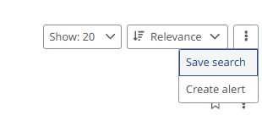
Results on the Hub – save a search or alert
Click the three dots at the top of your search results
Saved searches can be given distinct names and descriptions to make them easier to find
When setting an alert you can set
  How often it comes
  Whether you get an email even if there are no new results
  Whether you get sent a first email with an initial large set to results
Notes:
Notes
Saving a search this way will include any sets you have combined to create this final set. If you want to save all of your recent activity then you can tick them all and combine with OR.

Slide 24
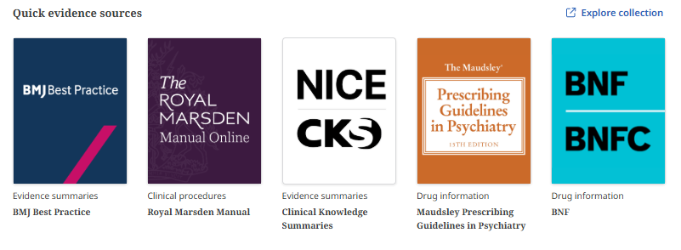
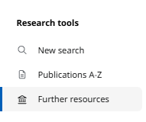

Taking a query elsewhere
The Hub is not the answer for all questions!
Key evidence resources are linked from the home page
See Further resources for Medline, CINAHL etc
Don’t forget Ask-A-Librarian for search help – click the bubble bottom right on every screen

